Slide 1
Popularity-Based Prefetching for Video Streaming in Named Data Networking
By Henrik Buhl
Supervisor: Rune Hylsberg Jacobsen

Slide 2
Agenda
Introduction
Background
TCP/IP
NDN
Implementation
NDN-simulation
Data extraction
Testing and Results
Conclusion

Slide 3
Introduction - motivation
Motivation:
The TCP/IP architecture struggles with high latency and bandwidth waste in video streaming. Named Data Networking (NDN) addresses these issues with in-network caching, improving data retrieval and reducing congestion. However, traditional prefetching fails to account for dynamic user behavior, leading to inefficient caching and bandwidth usage.

Slide 4
Introduction – Purpose and goals
Purpose:
“Explore how user engagement data specifically information about which segments of a video are frequently viewed or skipped can inform more intelligent prefetching strategies in NDN.”
Goals:
Identify segments of content that are frequently accessed or skipped.
Prefetch and cache popular segments closer to the user to reduce latency.
Minimize unnecessary data transfers and improve overall QoE.

Slide 5
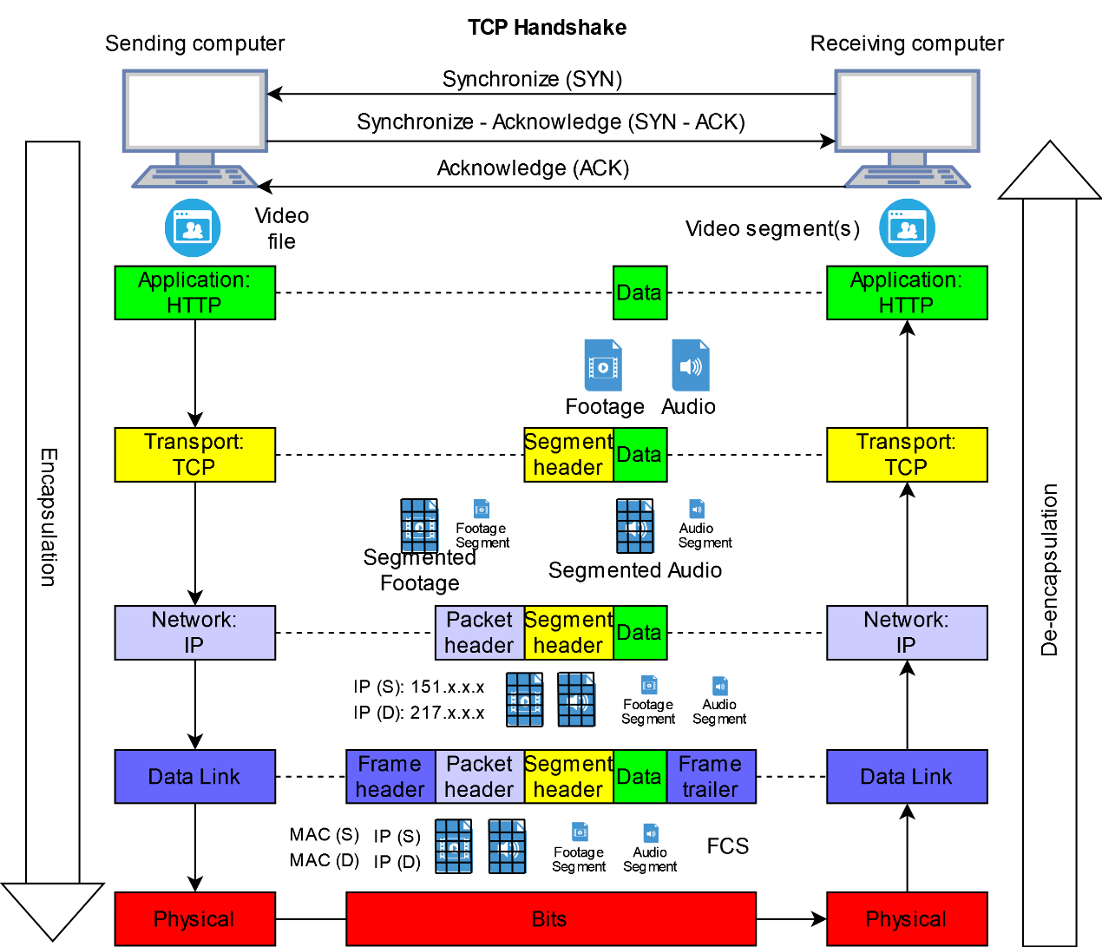
Background – TCP/IP
TCP Handshake
Get request
Fragments
Routing
MAC and Checksum

Slide 6
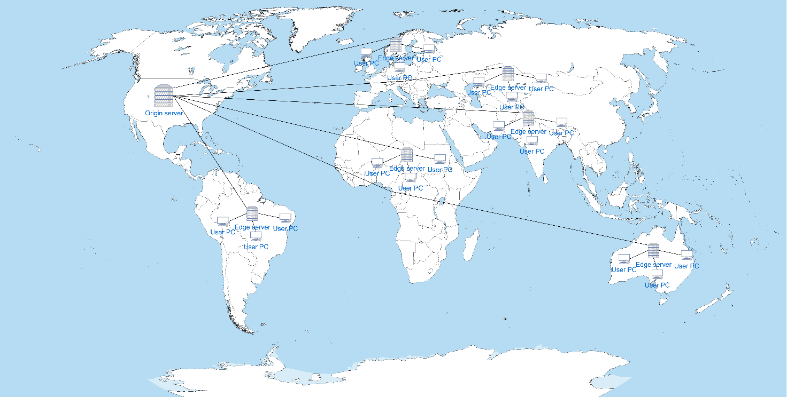
Background – TCP/IP HAS
Source: https://teyuto.com/blog/what-is-mpeg-dash-history-pros-and-cons-of-dash
Notes:
Video Preparation: The server encodes the video into multiple bitrates, segments it, and generates a manifest file.
Client Initialization: The client downloads the manifest file and begins playback by fetching the first segment.
Dynamic Adaptation: The client monitors network conditions and adjusts the bitrate of subsequent segments dynamically.
Segment Requests: The client requests segments one at a time, ensuring efficient use of bandwidth.
Playback: The client buffers and plays the video, adapting to network changes seamlessly.

Slide 7
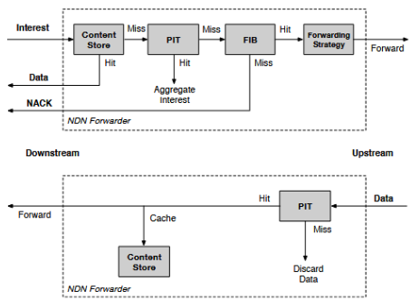
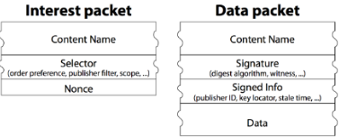
Background – NDN
NDN Forwarding and caching.
Notes:
A consumer sends an Interest packet for data through a router.
The router checks its Content Store:
Hit: The data is retrieved
Miss: The router checks the PIT.
If the PIT has a matching entry, then the request is aggregated under existing entries.
If the PIT misses, then the FIB checks for a valid route:
No route: A NACK is sent back.
Route found: the interest is forwarded upstream.
As data travels, downstream forwarders may cache the data based on the placement policy.

Slide 8
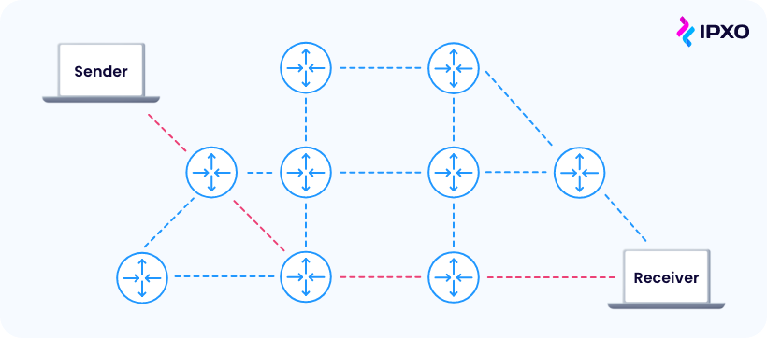
Background – NDN policies
Placement policies
LCE, LCD, MCD
Replacement policies
LRU, LFU, FIFO
Source: https://www.ipxo.com/blog/network-routing/

Slide 9
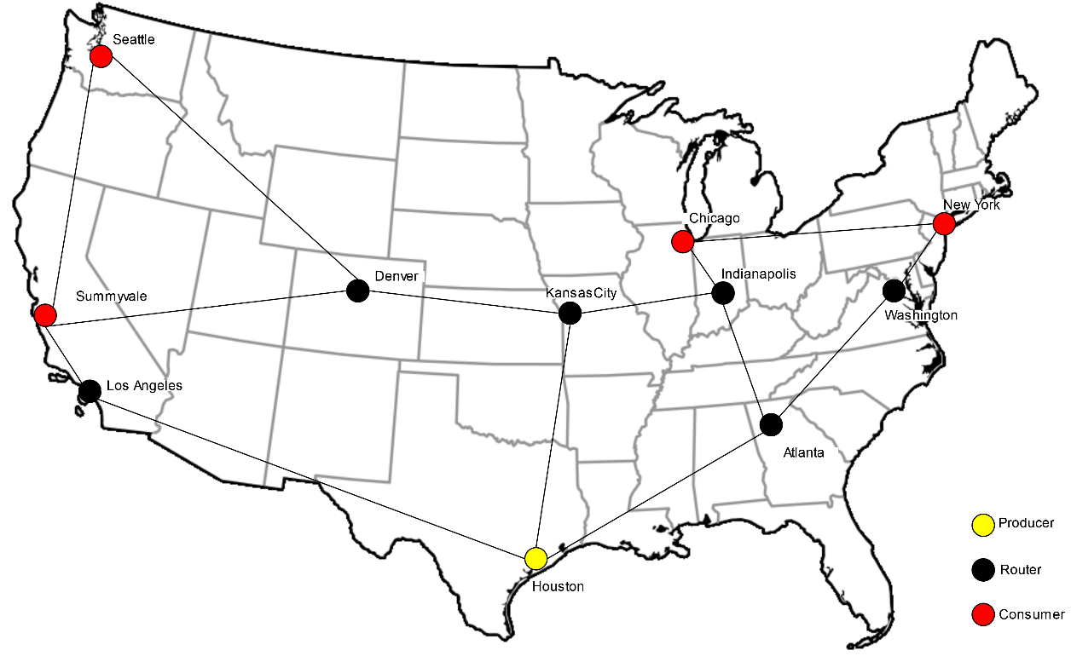
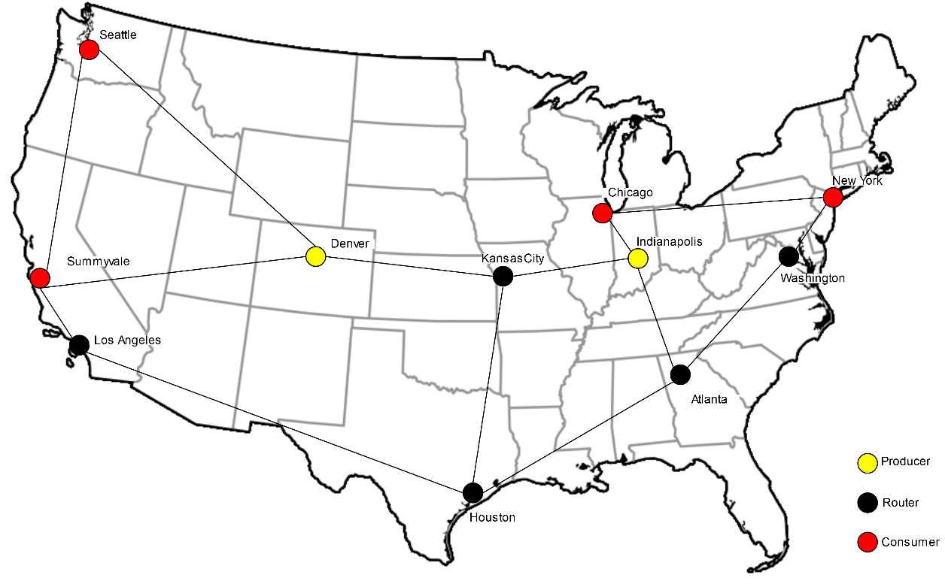
Implementation – NDN-sim Topology

Slide 10
Implementation – NDN-sim Scenarios
Scenario 1: Simulate CDN like behaviour as it is being used today. Using NDNsim I disabled caching and the placement and replacement policies. Scenario 2: Simulate NDN with standard caching mechanisms, such as LCE and LRU. Scenario 3: Simulate NDN without standard caching mechanisms, but with popularity-based prefetching. Scenario 4: Simulate NDN with standard caching mechanisms and with popularity-based prefetching.

Slide 11
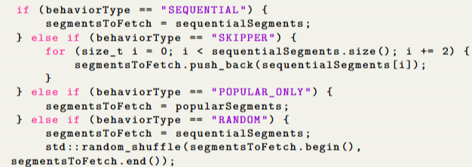
Implementation – NDN-sim “Users”
Sequential Behaviour: From start to finish
Skipper Behaviour: From start to finish skipping every other segment
Popular-Only Behaviour: Only wants the most popular segments
Random Behaviour: Requests all segments in a random order
Notes:
Husk at det er måske ikke super akademisk, men det er en simulation da der kun er 4 consumers og der kommer alt for meget data I forvejen

Slide 12
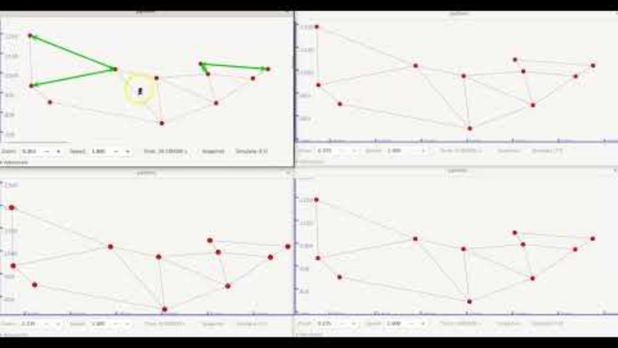
Implementation – Simulation showcase

Slide 13
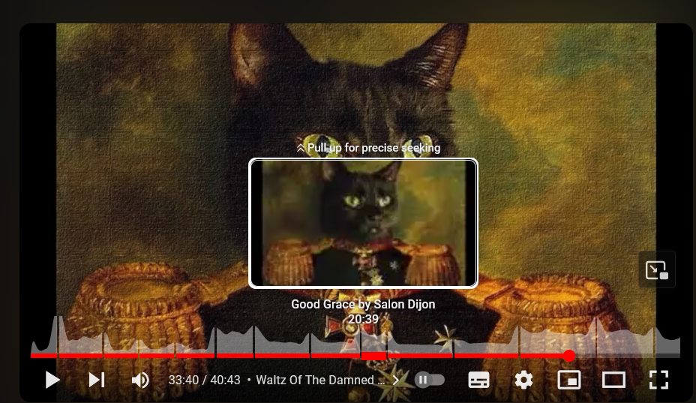


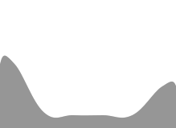

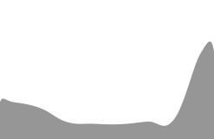









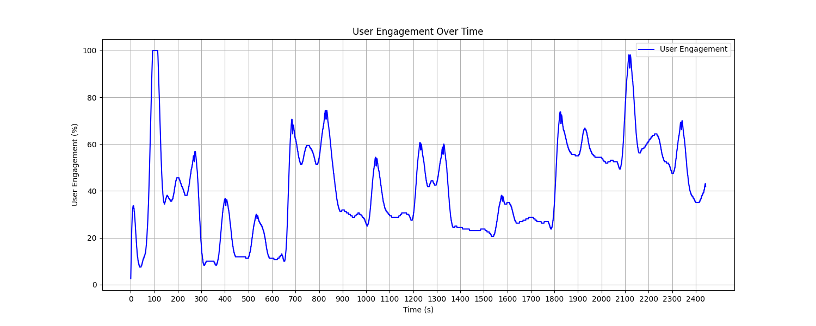
Implementation – Data extraction
The script made for data extraction works like so:
It retrieves stored SVG heatmaps from the video using web scraping.
The SVGs are converted to PNG format, allowing pixel-level data analysis.
Engagement data is extracted from the PNGs and saved in a CSV file.
This data is then used to identify popular video segments and recreate graphs that align with the original heatmaps.

Slide 14
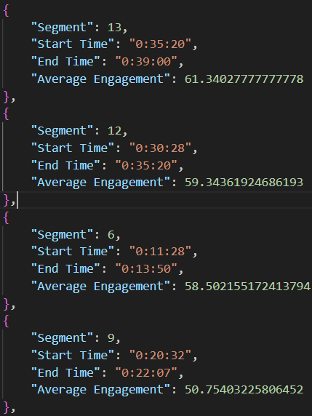
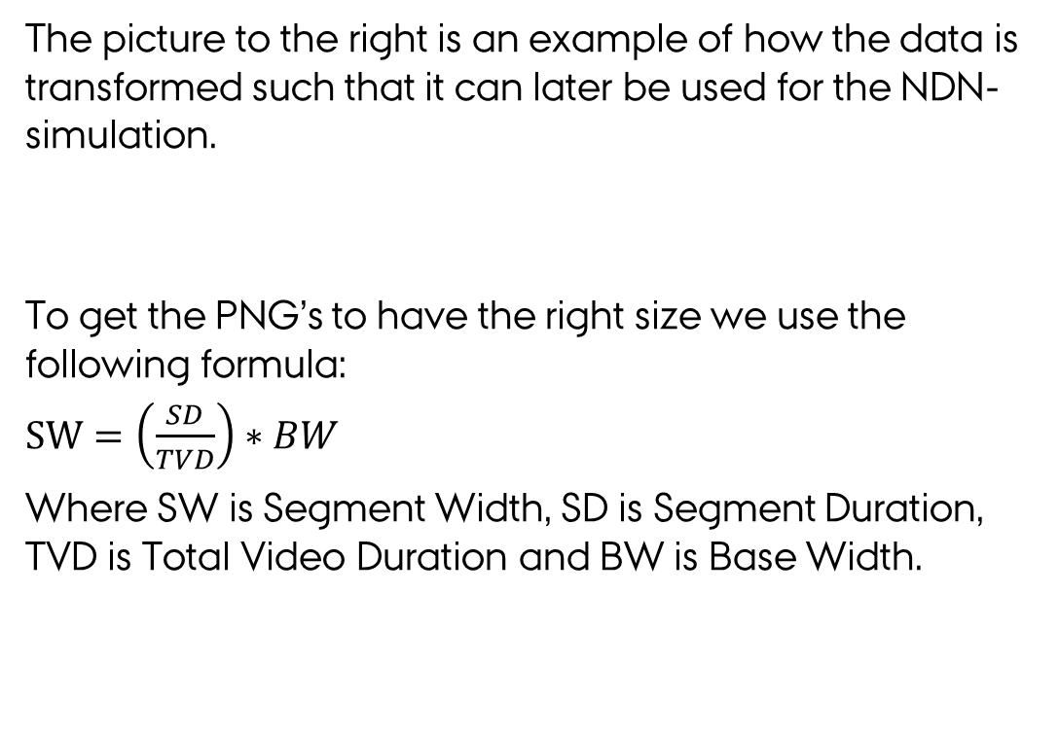
Implementation – Data extraction
The picture to the right is an example of how the data is transformed such that it can later be used for the NDN-simulation.
To get the PNG’s to have the right size we use the following formula:
$SW=\left(\frac{SD}{TVD}\right)∗BW$
Where SW is Segment Width, SD is Segment Duration, TVD is Total Video Duration and BW is Base Width.

Slide 15
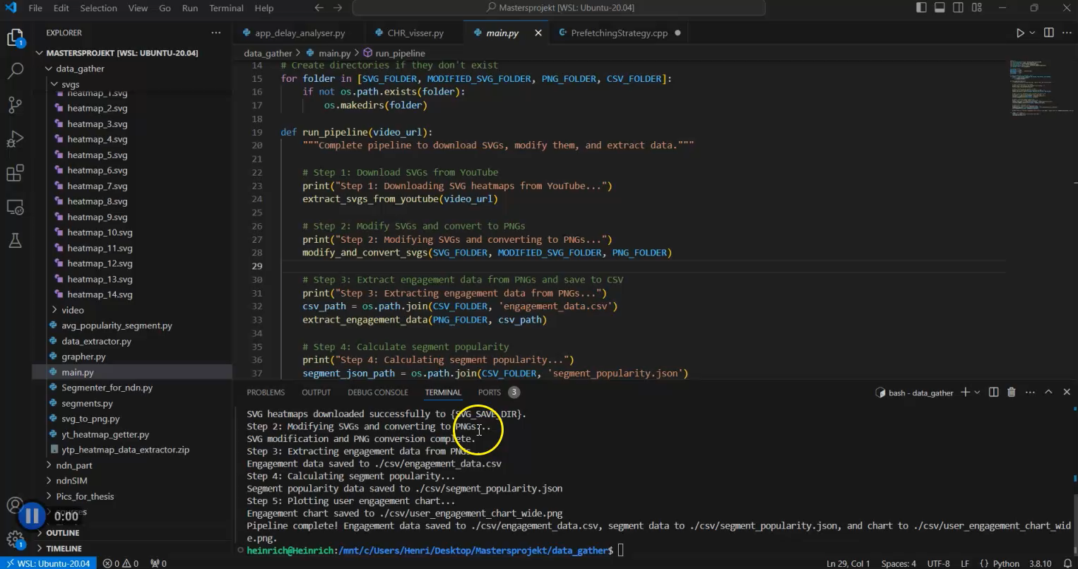
Implementation – Extraction showcase

Slide 16
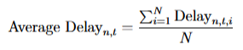
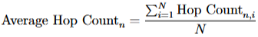
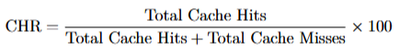
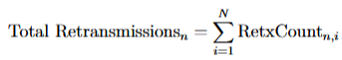
Metrics and results
Metric | Scenario 1 | Scenario 2 | Scenario 3 | Scenario 4
Delays (µs) | 622 - 622 | 2400 - 2400 | 1725 - 1798 | 1059 - 1059
Hop Counts | 1.0 - 1.0 | 3.0 - 3.0 | 2.0 - 2.0 | 2.0 - 2.0
Retransmissions | 5312 - 5312 | 399 - 400 | 5246 - 5312 | 5246 - 5312
Cache Hit Ratio | N/A | 24.56% - 24.56% | 21.52% - 24.08% | 21.69% - 24.08%
Notes:
Delays skal vægtes højst

Slide 17
Conclusion
Goals:
Identify segments of content that are frequently accessed or skipped. ✅
Prefetch and cache popular segments closer to the user to reduce latency. ✅
Minimize unnecessary data transfers and improve overall QoE. ✅ Kind of …

Slide 19
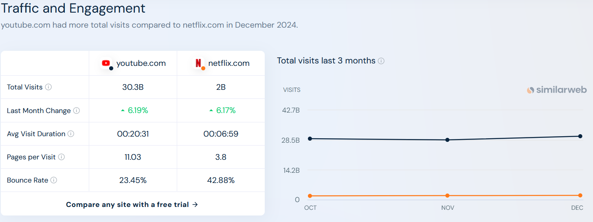
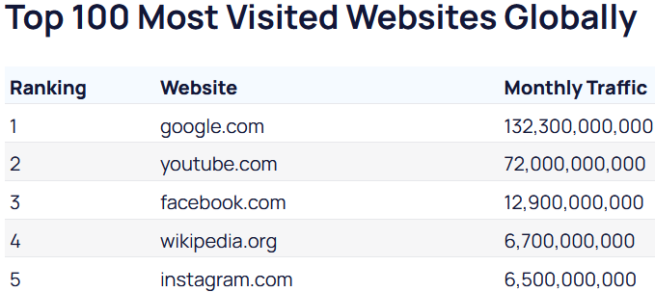
The real king of streaming
“YouTube made up 9.7% of all viewership on connected and traditional TVs in the U.S. in May”
Source: https://www.cnbc.com/2024/06/26/youtube-streaming-dominance-media-strategy.html
“YouTube primarily uses TCP for its video streaming service. TCP's reliability and error-checking mechanisms align with YouTube's goal of delivering high-quality video content without loss or corruption.”
Source: https://www.gumlet.com/learn/tcp-vs-udp/
Source: https://www.similarweb.com/website/youtube.com/vs/netflix.com/#ranking
“As of November 2024, the most visited website in the world is Google. The next most popular websites are YouTube, Facebook, Wikipedia, and Instagram.”
Source: https://explodingtopics.com/blog/most-visited-websites

